Slide 1
NoodleTools
NoodleTools allows you to create notecards in your project.
You can create quotes, paraphrase, and write in your words.
You can tag and color code the notecards.
How to Create Notecards
Lost Mountain Middle School

Slide 2
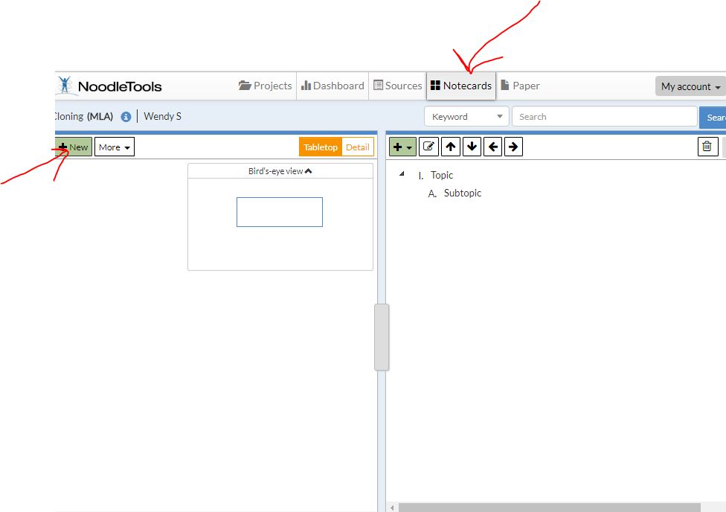
Click on the notecard tab and then “new”

Slide 3
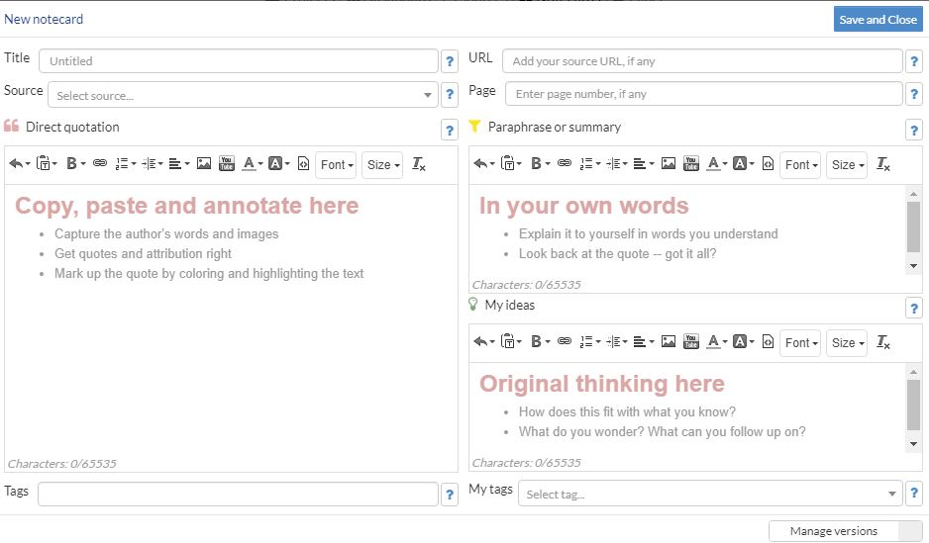
Fill in as much information as you can here. -Notecard Title -Source/Citation -Quotations from source -Your own words -Your thinking on the words - Add a tag which is the subject and a title for your notecard.

Slide 4
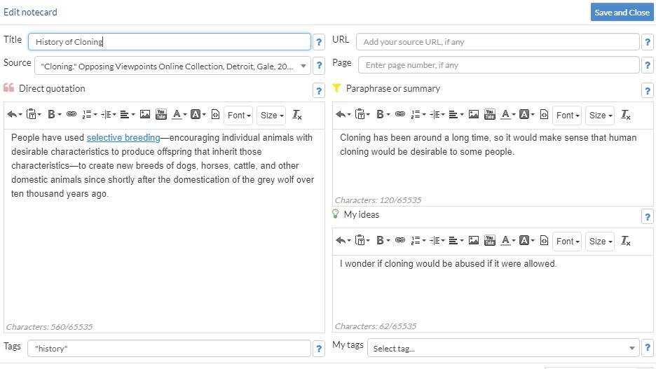
Here is an example 1. Title the quotation 2. Copy and paste quotations. 3. Paraphrase the quotation 4. Type what you think about the author’s words. 5. Add the source. -

Slide 5
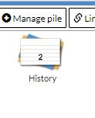
After creating notecards, you can organize the subjects by color or stack them. (Click on the card and choose a color)

Slide 6
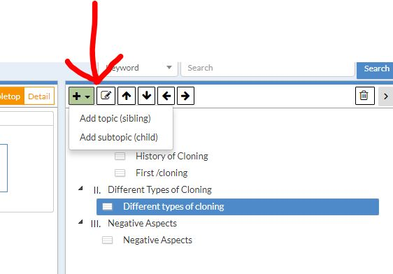
Add topics and subtopics from Notecards.

Slide 7
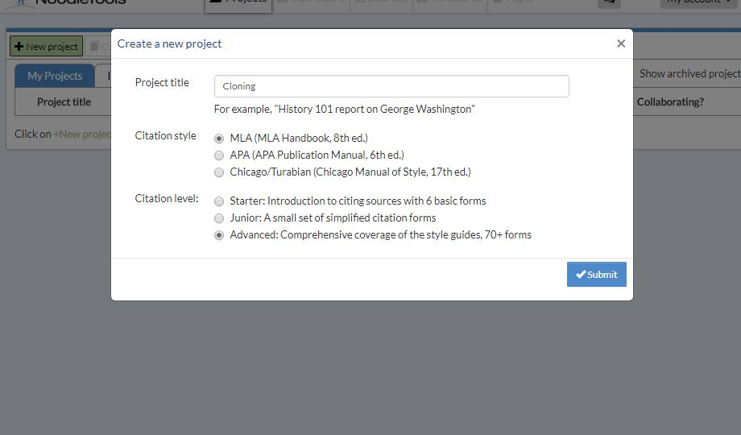
A paper is saved in your Office365 account with the title you typed in your dashboard.

