Slide 1
NoodleTools: Printing your Citation Page “References” or “Works Cited”
Use NoodleTools to print your Citation page:
MLA = Works Cited
APA = References
NoodleTools will print your final citation page(s). You will need to set up (format) the page before you print.
Follow these directions. Make sure your final page adheres to the citation style that is required and that you have checked the capitalization rules for that style.
Lost Mountain Middle School

Slide 2
When you are ready to print your citation page, follow these instructions.
Go to the Projects Tab.
Choose the project you are working on.

Slide 3
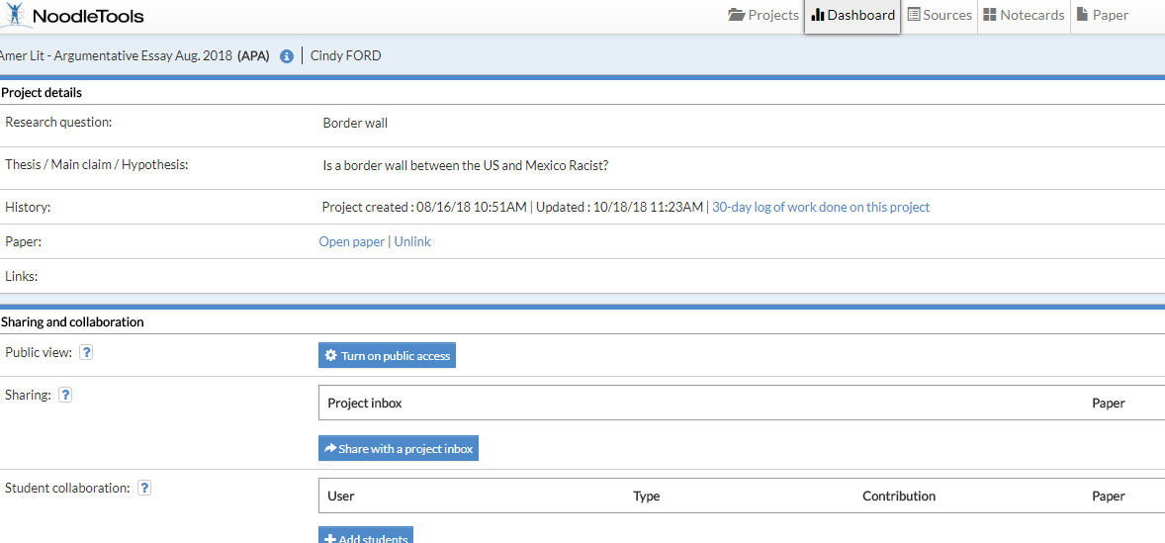
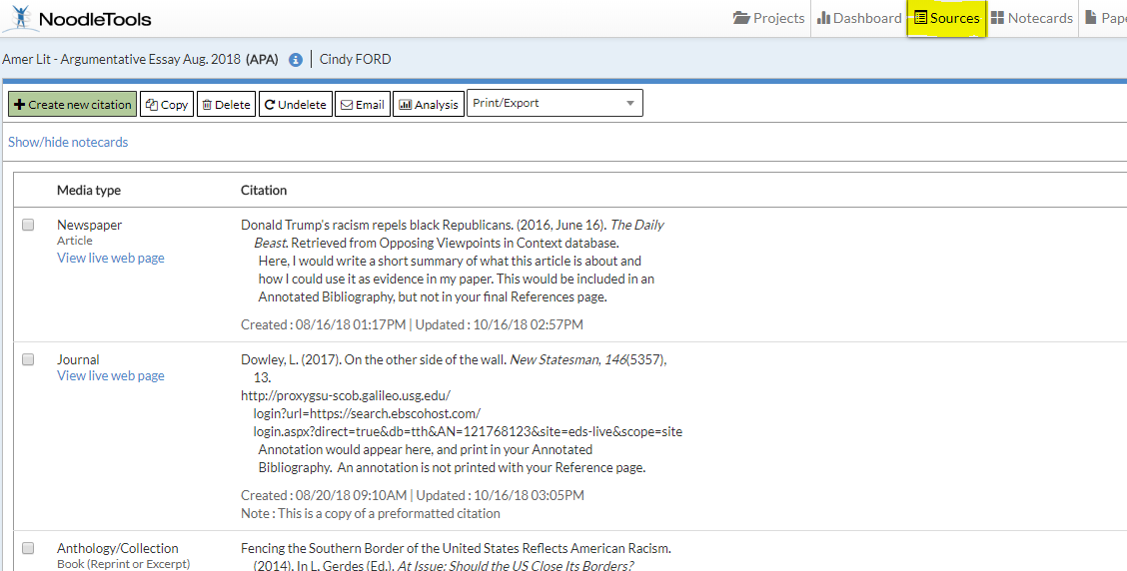
The Dashboard for this project opens. Notice - your project and citation style appear at top of screen. Make sure you have the correct citation style.
Now, click on the Sources tab to open your list of sources.

Slide 4
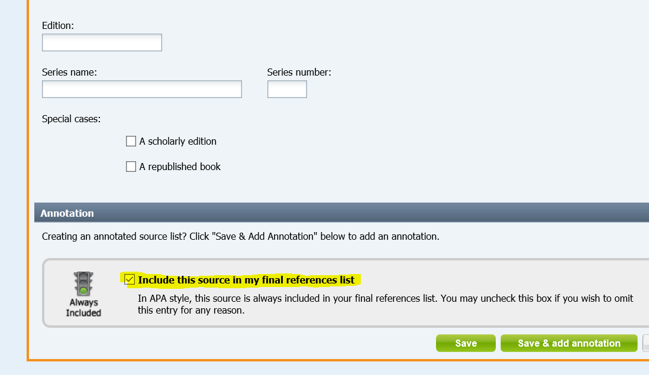
NoodleTools automatically includes every source in your Sources list
If you to omit a source from your final Reference or Works Cited page…
“Edit” the citation. Go to the bottom of the screen and UNCHECK the ‘include this source in my final referenced list”

Slide 5
To PRINT your citation page, you will need to set up (format) that document first.
While in your project Sources page:
Go to the Print/Export tab
Click on Formatting Options…

Slide 6
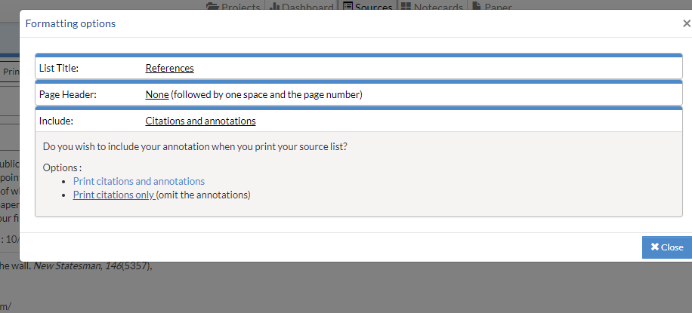
A window will open with the default List Title: “References” (APA) or “Works Cited” (MLA)
Here is an example of APA formatting page.
At the bottom of the screen, change “Include:” to Print Citations only (omit the annotations)- if you had any annotations.
Close this window. Then Print/Export to Word or Word Onlne.
APA STYLE
Change this to include citations only

Slide 7
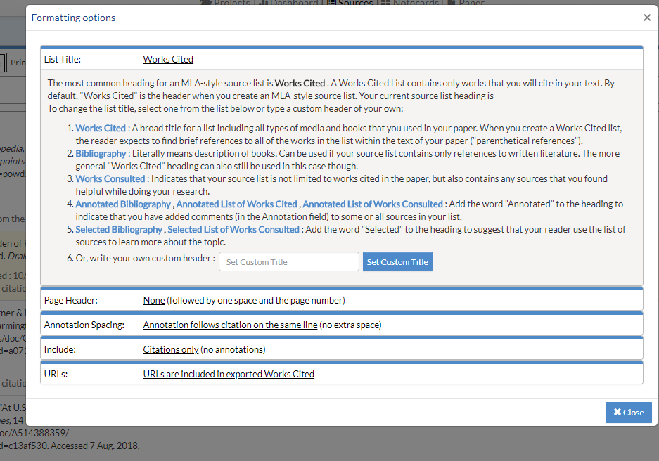
IF your source citations are in MLA style the “formatting options” look like this:
Here, because this is your bibliography only, make sure you choose
“Citations only (no annotations)”

Slide 8
Now you are ready to print your citation page.
Print/Export to Word
OR
Export to Word Online
Choose an option, open your document and PRINT
**make sure your title is References or Works Cited AND that you have NOT included the annotations.

Slide 9
For more information or questions about NoodleTools, see the series of Tutorials on our website.
Or, stop in and ask the library staff, we are happy to assist you☺
Lost Mountain Middle School

