Slide 1
NoodleTools: Printing your Annotated Bibliography
Use NoodleTools to print your Annotated Bibliography and Reference pages.
NoodleTools defaults to printing a References or Works Cited page, but you can change the formatting and set up to print your bibliography with annotations.
Lost Mountain Middle School

Slide 2
When you are ready to print your Annotated Bibliography page, follow these instructions.
Go to the Projects Tab.
Choose the project you are working on.

Slide 3
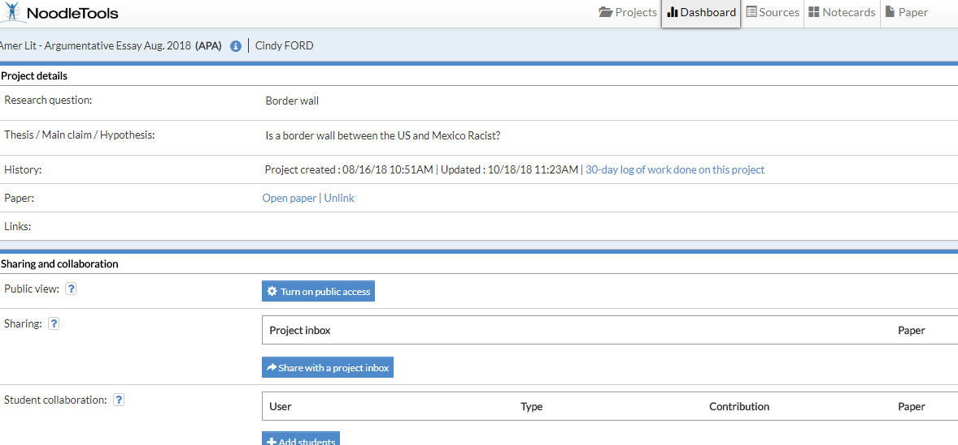
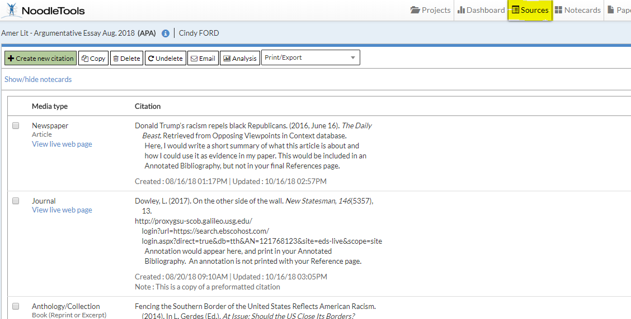
The Dashboard for this project opens. Notice - your project and citation style appear at top of screen. Make sure you have the correct citation style.
Now, click on the Sources tab to open your list of sources with their annotations.

Slide 4
To PRINT an Annotated Bibliography, you will need to set up that document first.
While in your project Sources page:
Go to the Print/Export tab
Click on Formatting Options…

Slide 5
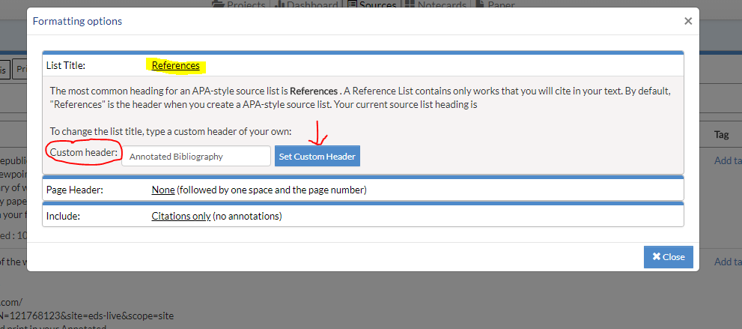
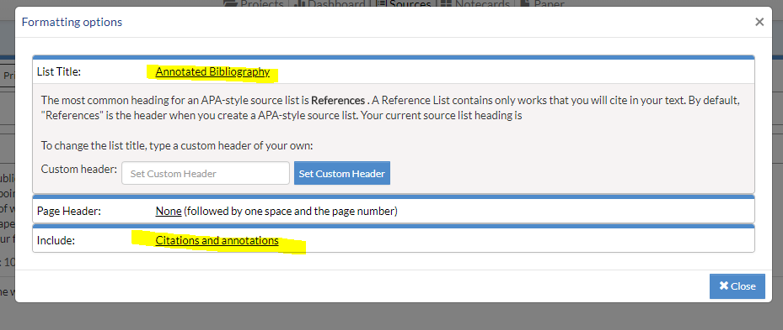
A window will open with the default List Title: “References”
You MUST change the List Title. . .
In the Custom Header box type “Annotated Bibliography” and click on the Custom Header button to change
Now your List Title is changed to “Annotated Bibliography”.
At the bottom of the screen, change “Include:” to Citations and Annotations
Close this window.
Change this to include both citations and annotations
Title is now changed
Page will now include both

Slide 6
Now you are ready to print your Annotated Bibliography page.
Print/Export to Word
OR
Export to Word Online
Choose an option, open your document and PRINT
**make sure your title is Annotated Bibliography AND that you have included the annotations.

Slide 7
For more information or questions about NoodleTools, see the series of Tutorials on our website.
Or, stop in and ask the library staff, we are happy to assist you☺
Lost Mountain Middle School

