Slide 1
NoodleTools: How to Cite
NoodleTools will help you cite your sources, create an annotated bibliography and a reference page.
This presentation shows how to cite sources in NoodleTools.
Lost Mountain Middle School

Slide 2
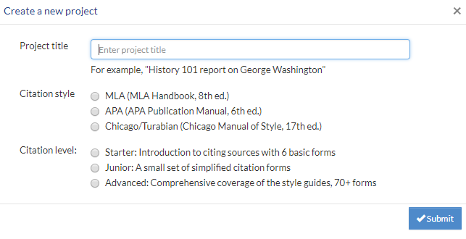
When you first open NoodleTools, the Project Tab is open.
To begin a new project, Click on "+New Project"
A "Create a new project" screen will appear. Here you
Title your project
Choose a citation style: MLA or APA
Choose Citation Level:
choose Advanced so that you get all the content about styles.

Slide 3
Dashboard Tab
Notice - your title and citation style appears at top of screen.
TheDashboard helps prepare you to write your paper. You can fill out the information now, or go straight to entering your sources by clicking on the SOURCES tab.
*notice that you can even add a "to-do list" to remind you!

Slide 4
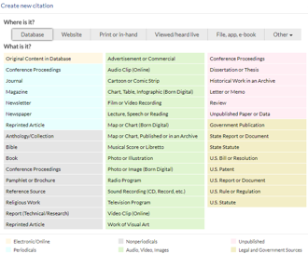
When you "Create new citation" -
NoodleTools wants to know where you found it... a database, a website, etc.
If database, use your best judgement to say where it was found..in a journal, magazine, etc. (this does not have to be perfect).

Slide 5
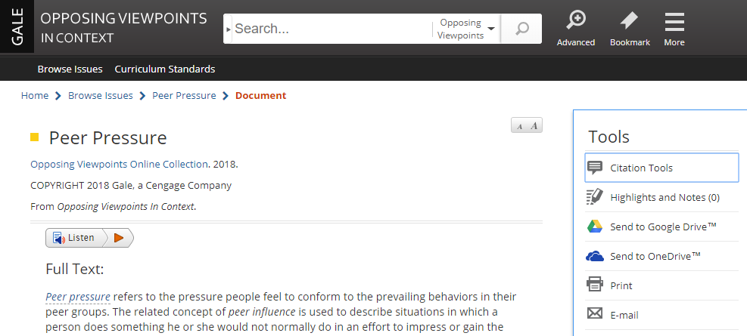
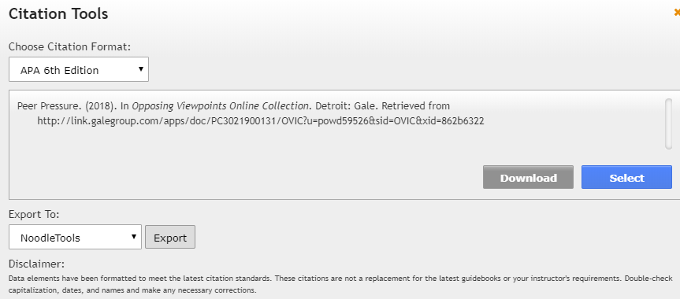
1. Importing a citation from GALE Resources in Cobb Digitatl Library
Most of the time you will add or create citations from Cobb Digital Library. There are two ways to do this:
Export from our Gale resources on Cobb Digital Library directly to NoodleTools**
**remember, you must check capitalization rules for APA/MLA and may need to edit the title
Make sure to choose style here

Slide 6
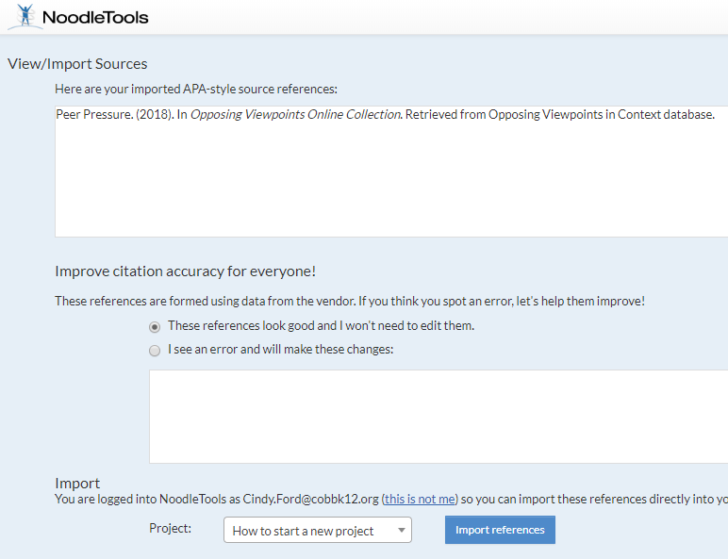
Notice the capitalization in this citation is incorrect for APA style- You need to correct it on the next NT screen. The title of the article should read -
Peer pressure.
In this NoodleTools window you will confirm your source, and import the citation into your project.
Make sure to choose the correct project if you have more than one in NoodleTools.
> Refresh your NT screen to see this source in your project page.

Slide 7
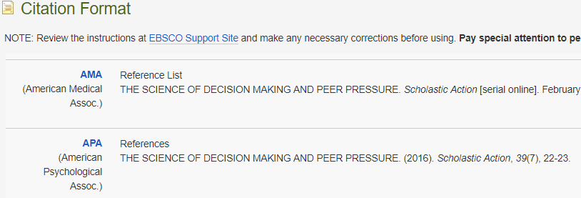
Some of the CDL databases do NOT export citations directly to NoodleTools. For these you will have to copy and paste the citation. So here is another way to cite with NoodleTools.
Cite
2. Paste in a citation from another source in CDL (i.e. Galileo)**
Permalink
**remember, you must check capitalization rules for APA/MLA and may need to edit the title​

Slide 8
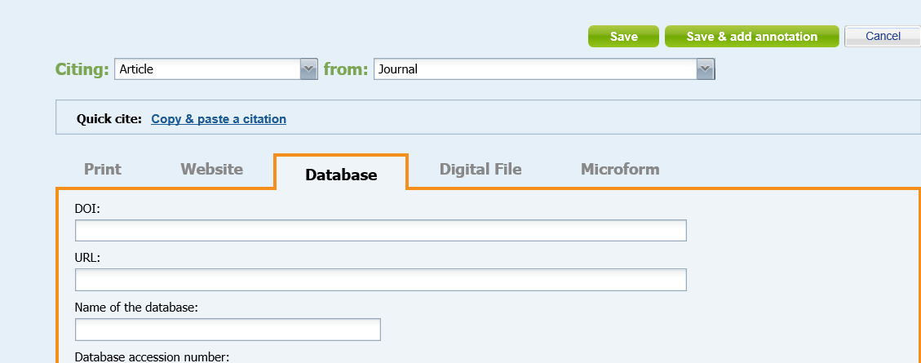
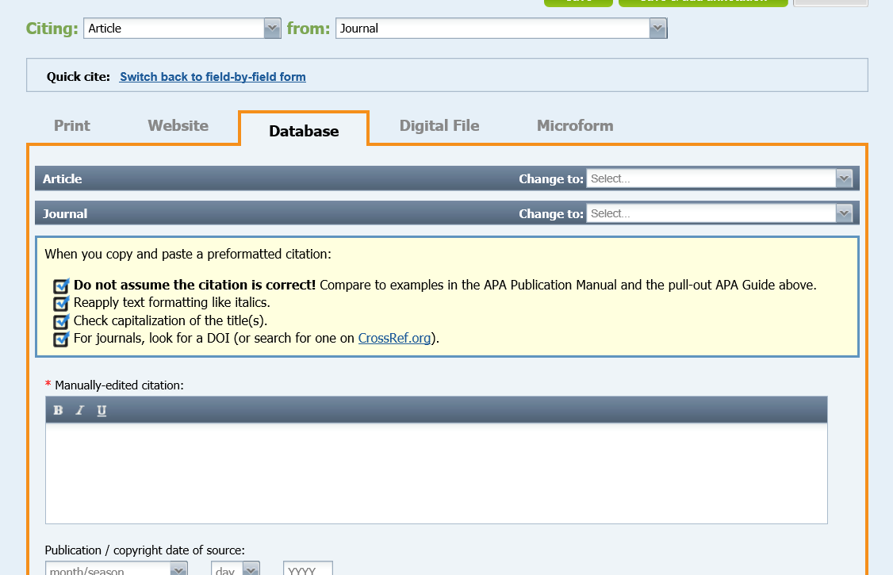
To COPY & PASTE a citation:
+New Citation
Select Quick cite: Copy & paste a citation.
Paste the citation into the text box.
Make sure to grab the Permalink so that you can get back to this article in CDL (see next page for how to)
Copy
Paste

Slide 9
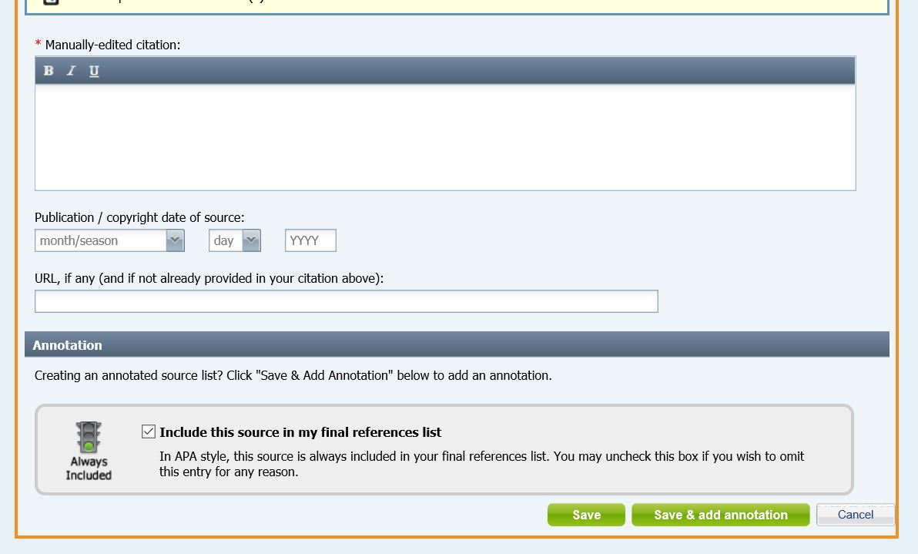
Next, Copy and paste the permalink Then submit.
What's a Permalink and why use it? It is an unchanging link to a URL. That means if you have the URL Permalink, you can easily return to your source.
***Note, capitalization rules for the citation style chosen.
Paste citation here. Check capitalization!

Slide 10
The third way you can cite is to manually create a citation**
Choose a tab for the type of source you used, fill in all the blanks that you can. Then, Submit, and NoodleTools will create a citation for you!
**remember, capitalization rules

Slide 11
For more information or questions about NoodleTools, see the series of Tutorials on our website.
Or, stop in and ask the library staff.
Coming next: Creating a Reference page or Annotated Bibliography page
Lost Mountain Middle School

